Slide 1

SPLITBILL An Android Expense Management Application
Team Alpha

Slide 2


What does our app do?
Split bills with friends and family
Useful for roommates to share their room expenses
Check out how much your friend owes you or you owe your friend

Slide 3
Features
Login screen
Registration screen
Home screen
Groups
Friends (finding friends accepting their request)
To Get and Give
Adding, removing the bill information
Push notifications
Adding the bill image

Slide 4
Technologies
Client side :
Android framework
Java
SQLite
Data bind libs

Slide 5
Server Side Technologies
Java
Spring Boot
Hibernate
Database
MySQL
phpMyAdmin
MySQL Workbench

Slide 6
Tools Used
Build tool : Gradle
Continuous Integration: Jenkins
Testing : Manual Testing and Junit testing (future)
Instant messaging and team communication : Asana, Slack
Code management : GitLab
Documentation: Wiki

Slide 7
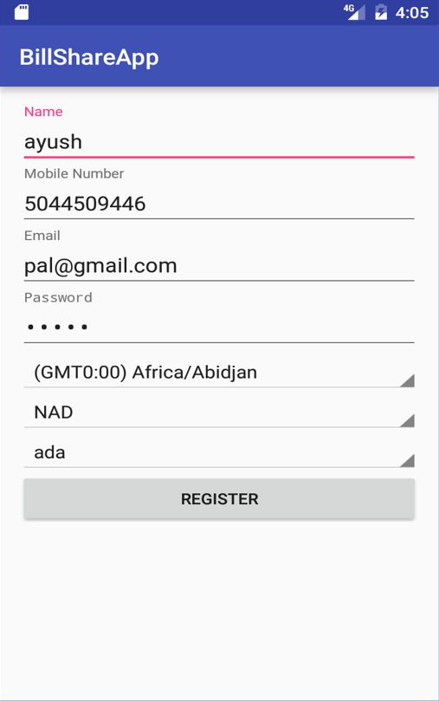
Registration Page
Country : sets time zone accordingly
Currency : according to country it automatically selects currency
Language preference : default English
Input selection criterion fro all fields

Slide 8
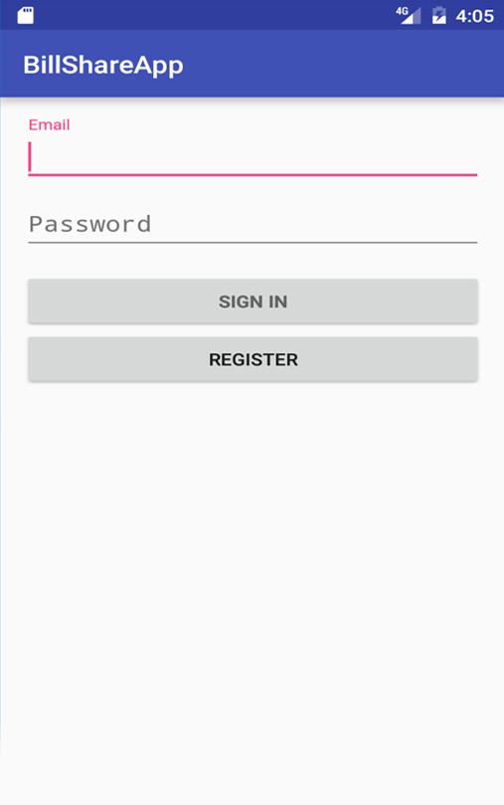
Login Page
Features:
Autocomplete
Checks both fields are non-empty
Check the criteria for password field
1: minimum 6 character
2: should contain character and numbers

Slide 9
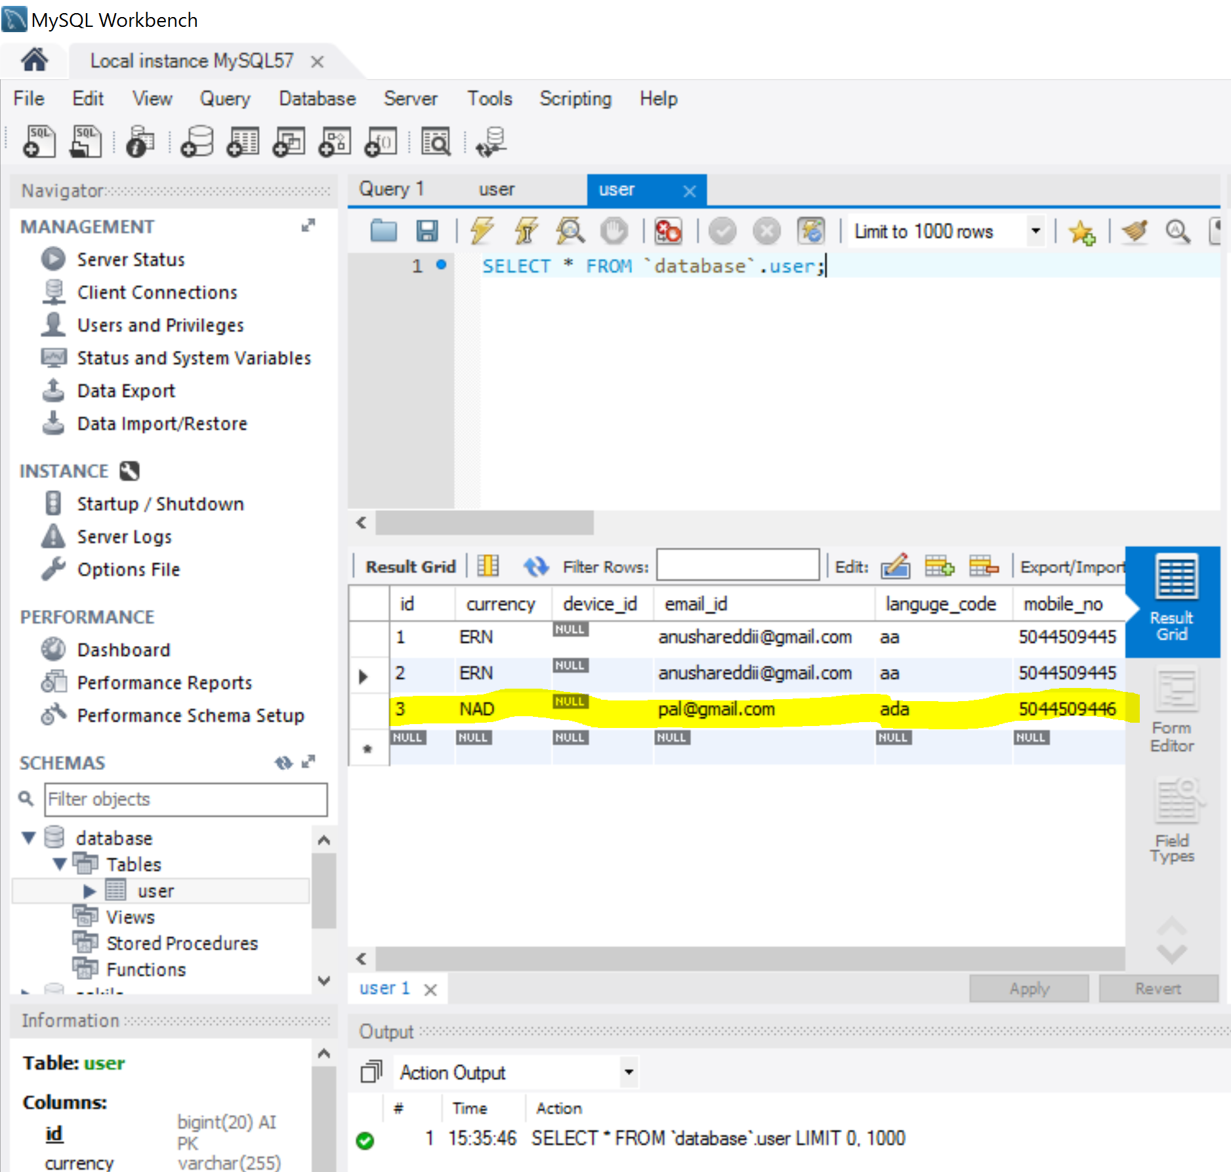
Sample Data

Slide 10
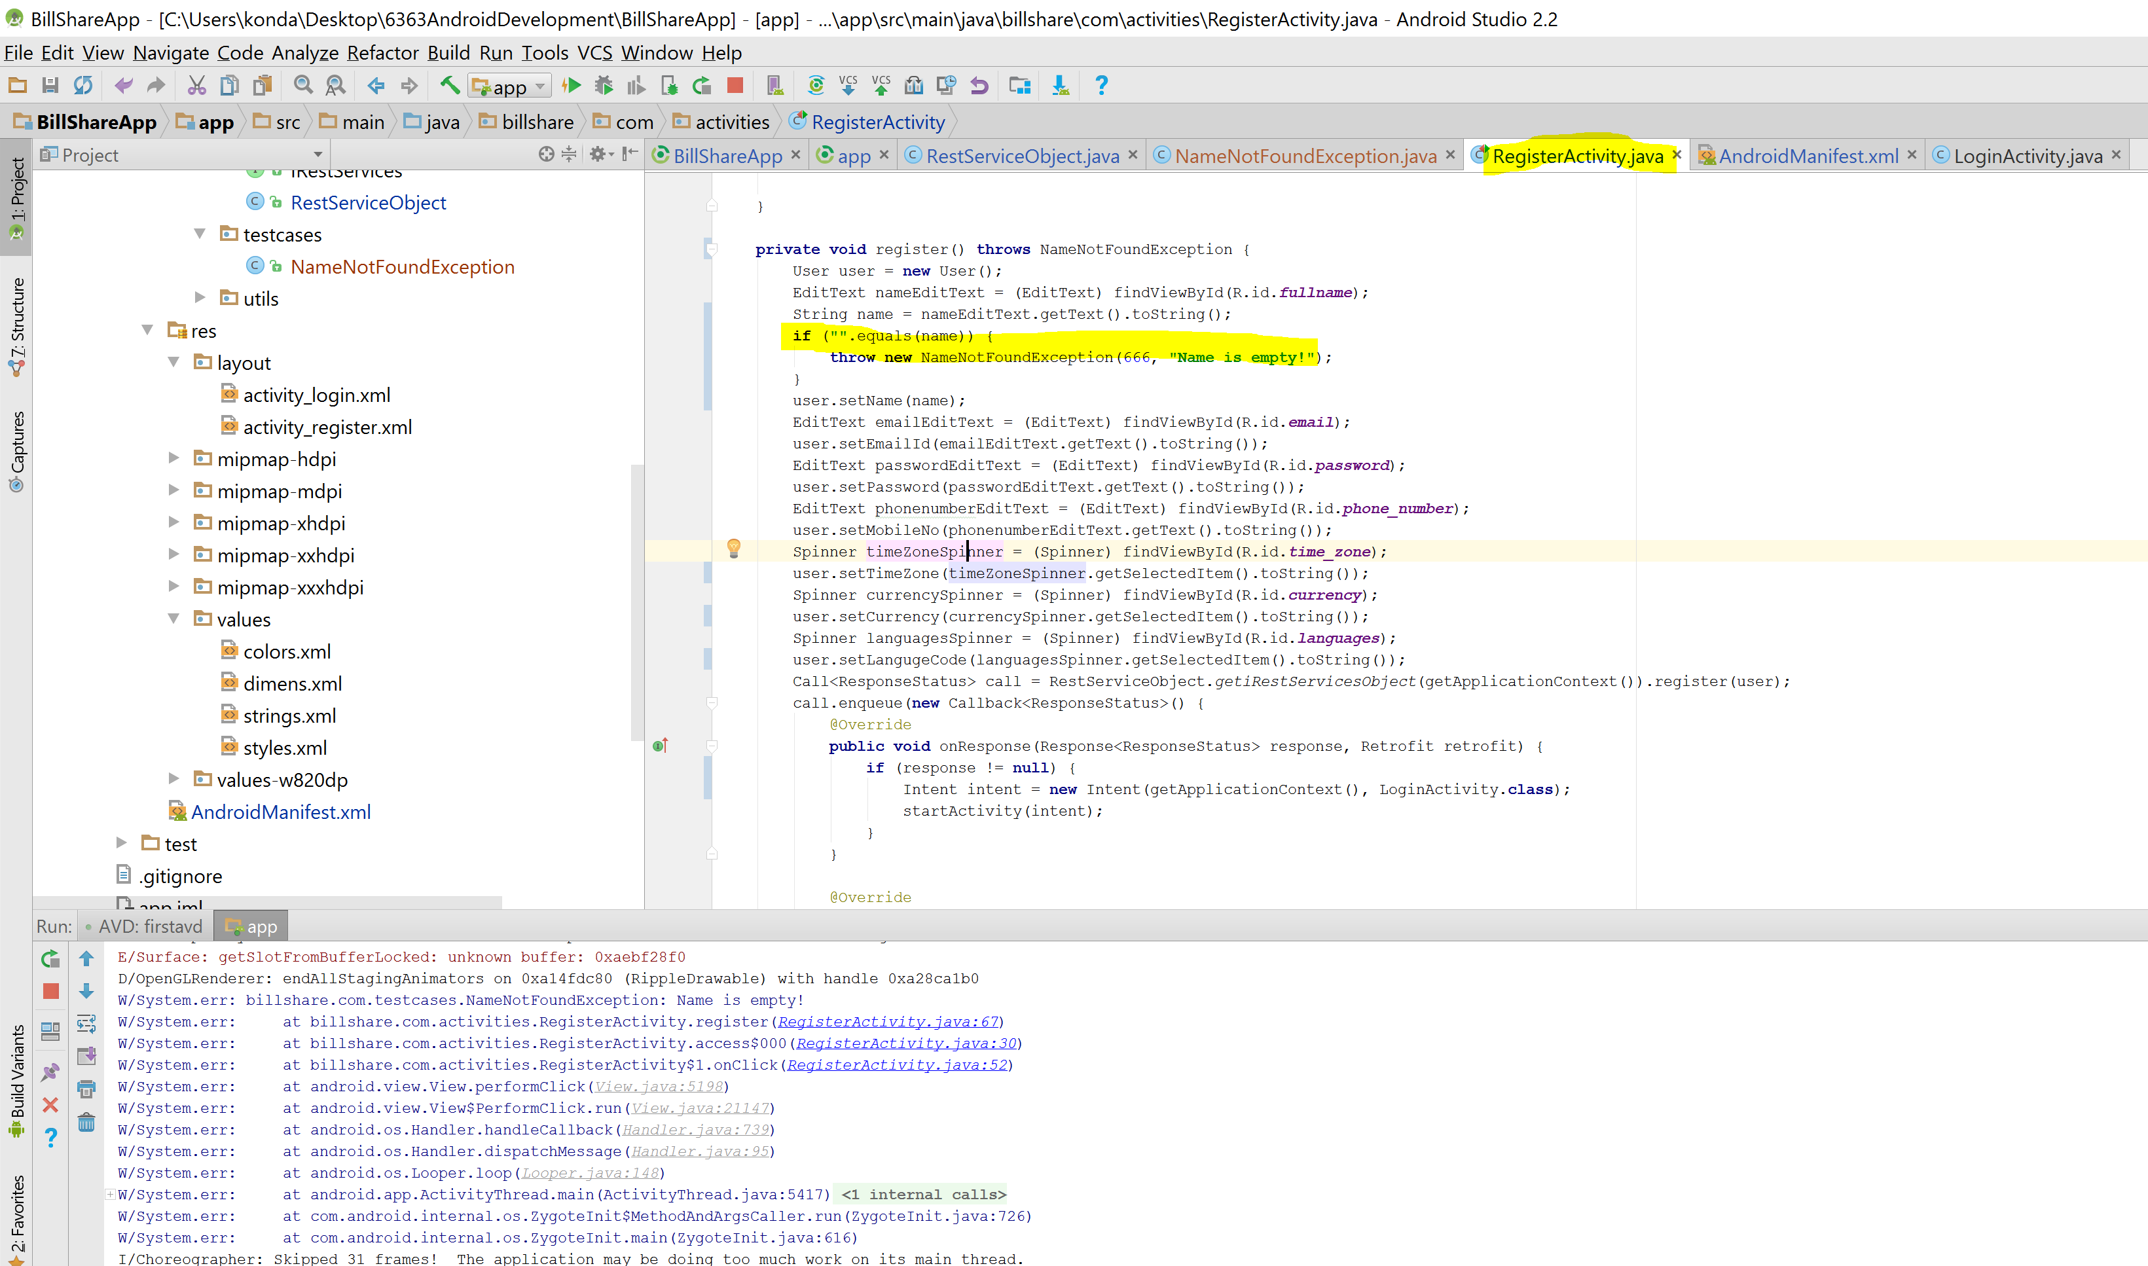
Test Cases: Exception Handling

Slide 11
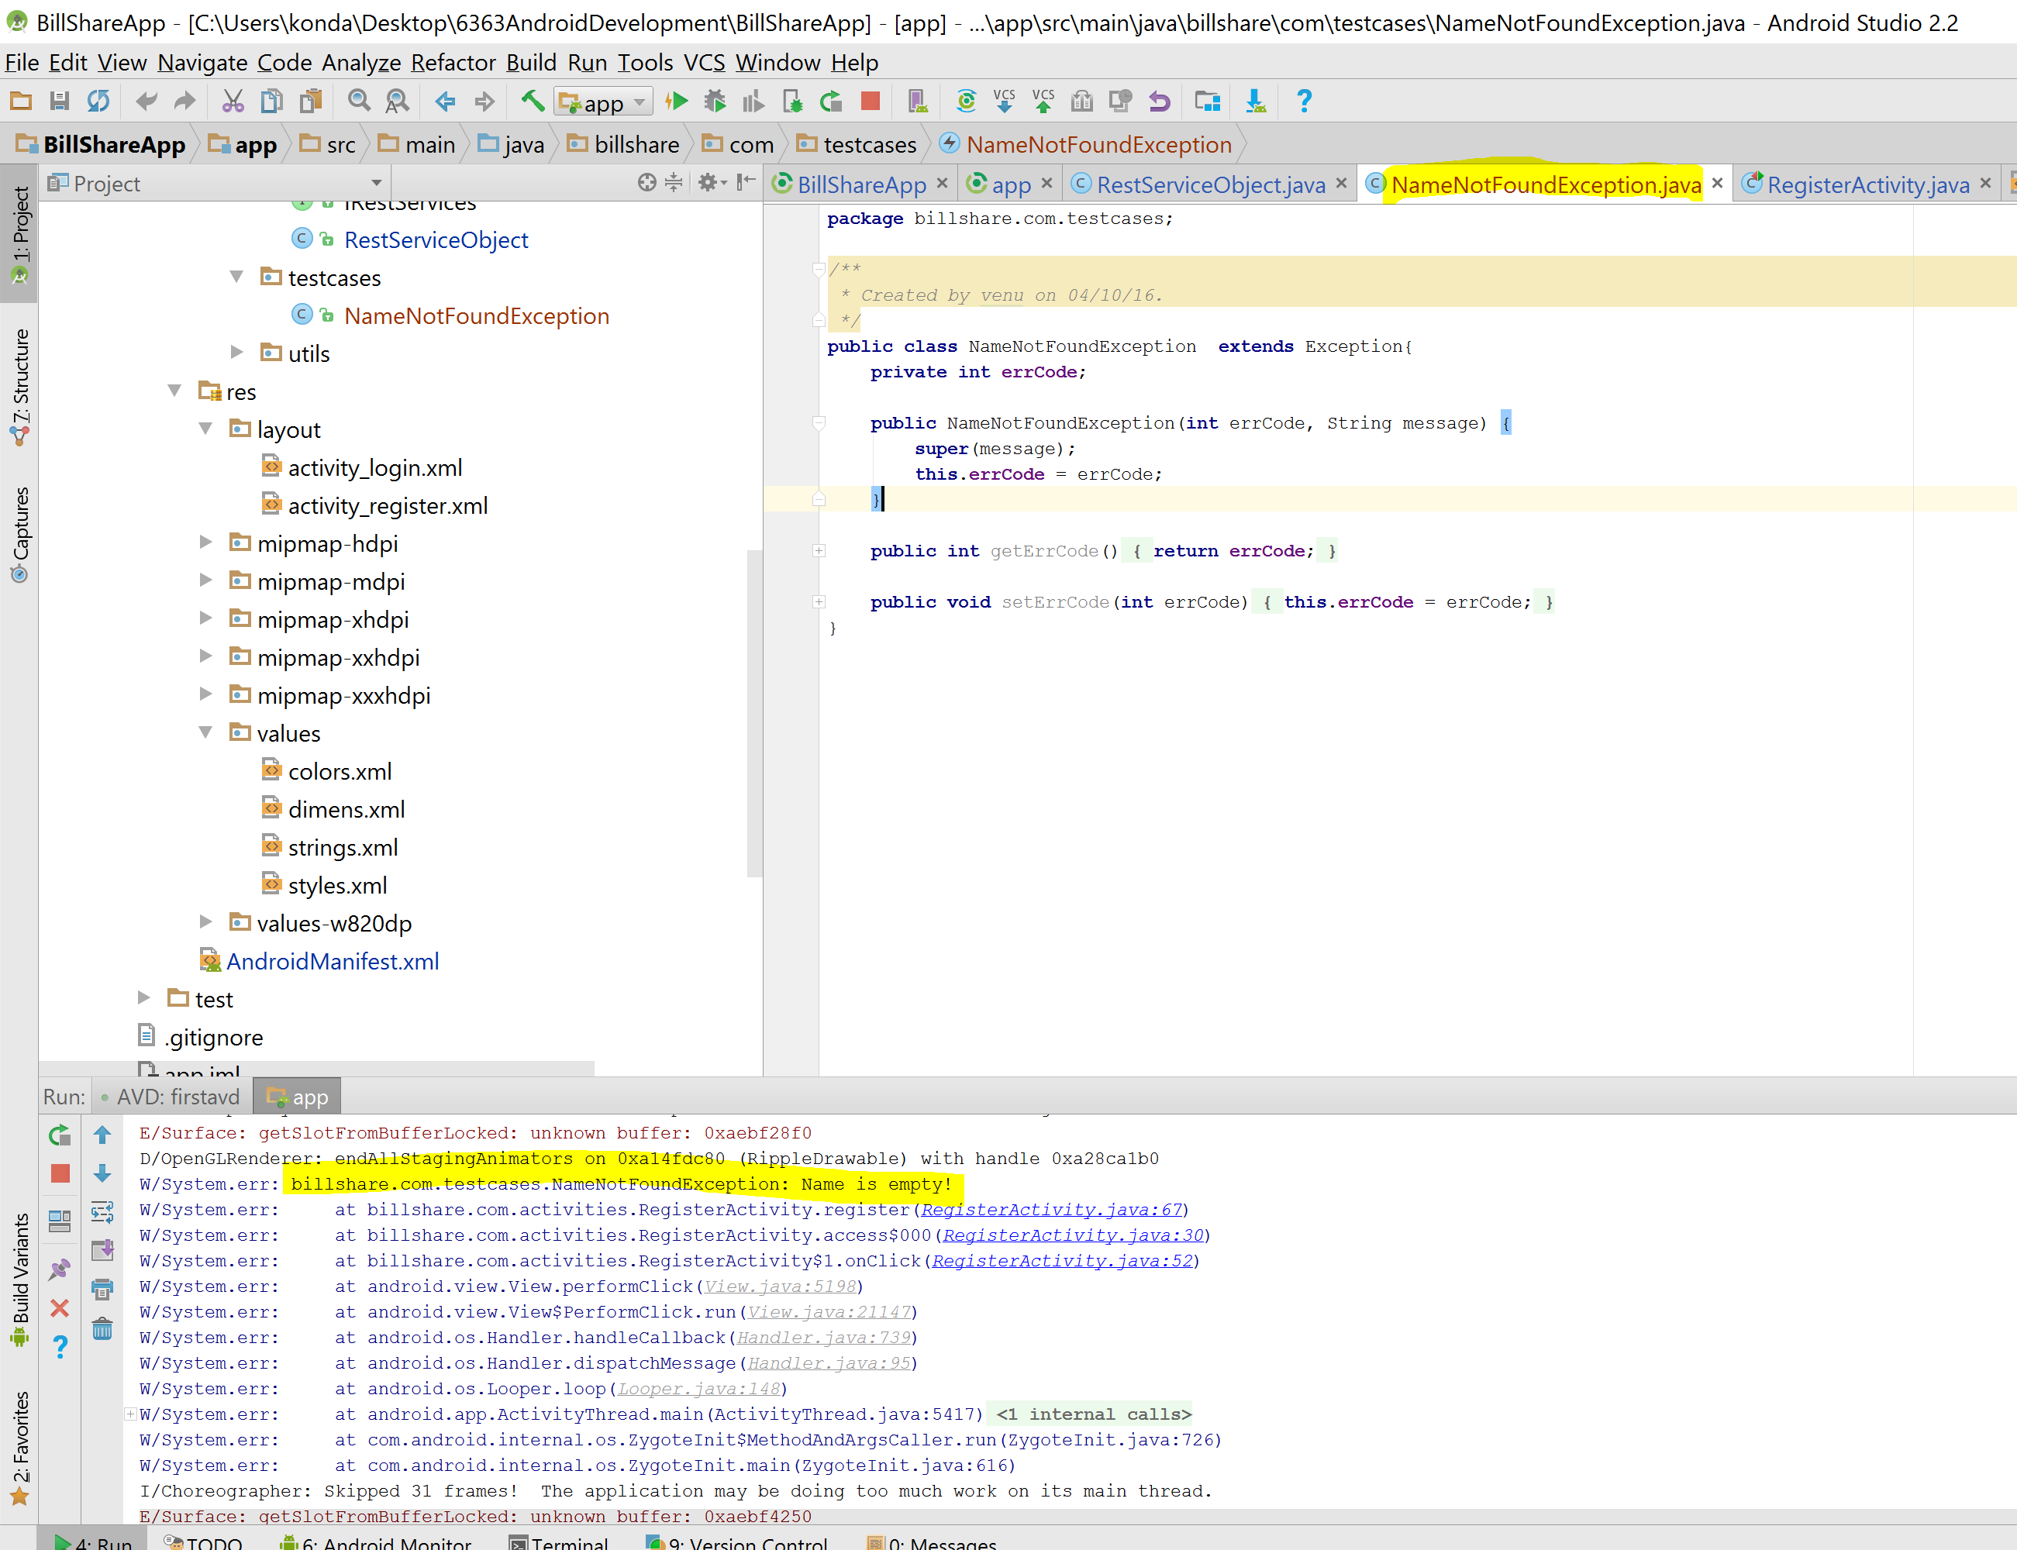
Test Cases: Exception Handling

Slide 12
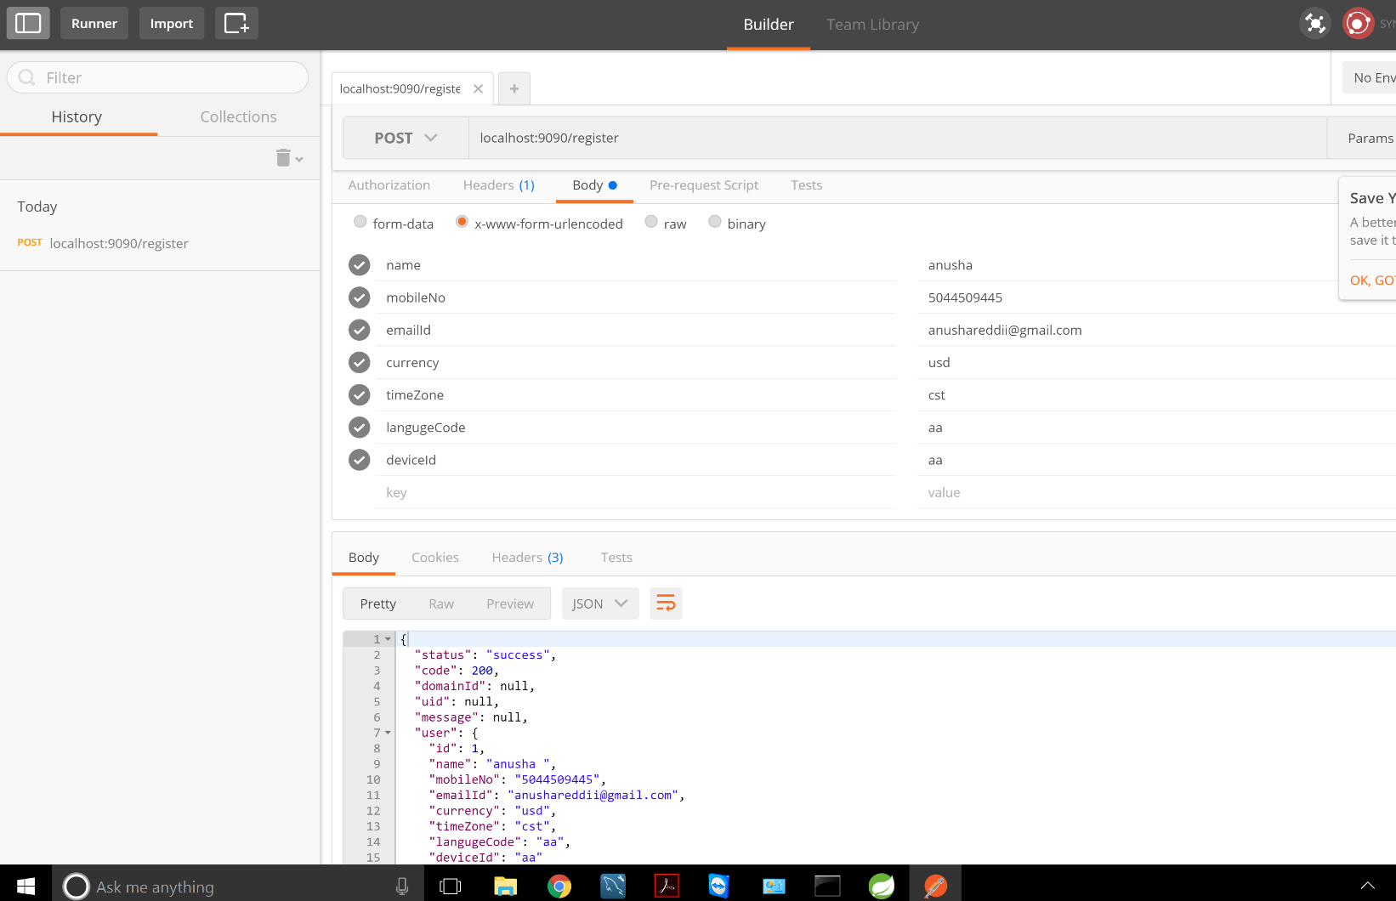
Server Side API Testing
Postman

Slide 13
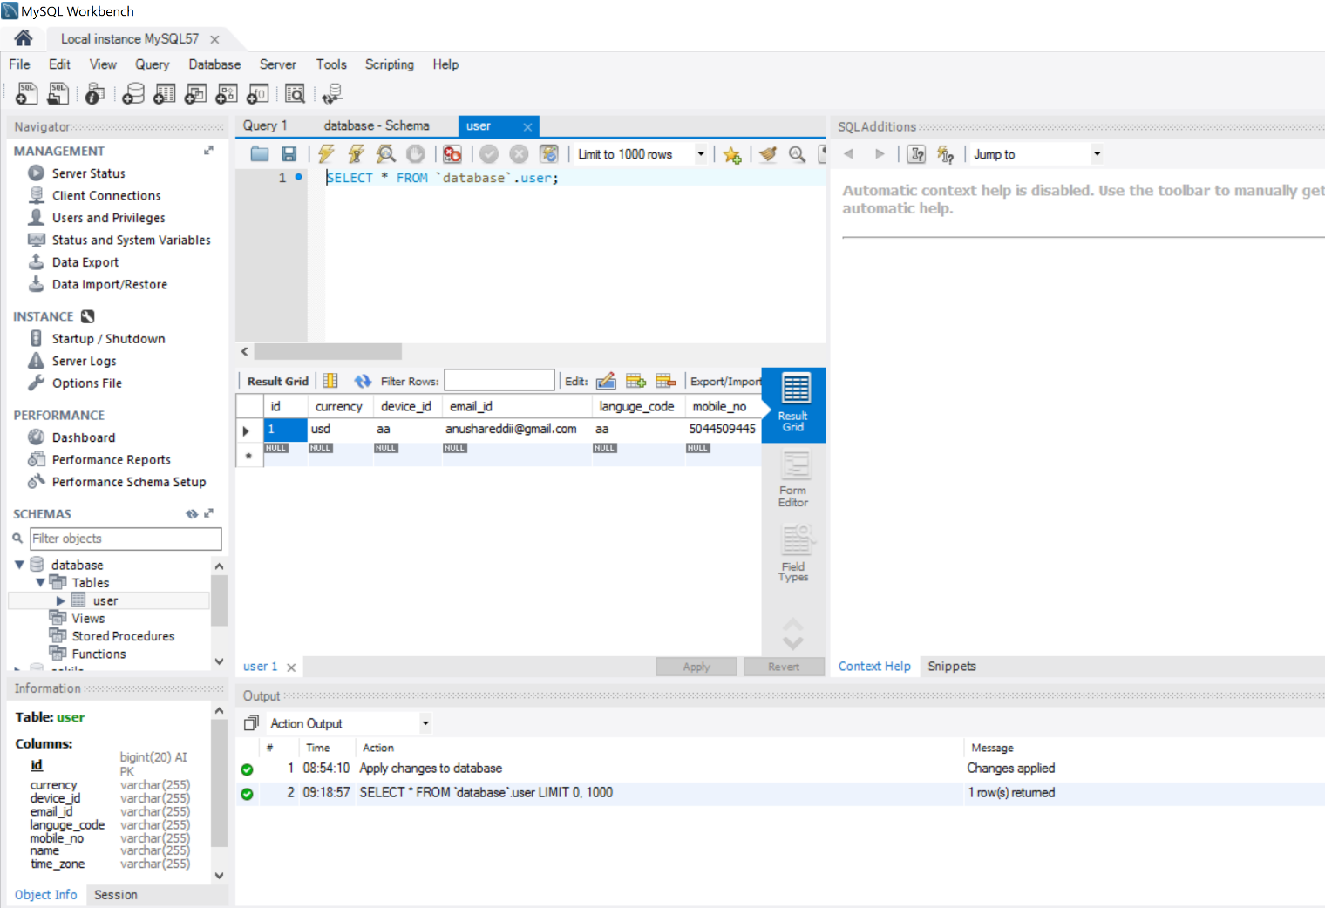
Data Posted

Slide 14
Database
MySQL 5.7.15 (Ubuntu)
13 tables
Expenses
Users
user_expenses
friends
Groups
group_members
group_expenses

Slide 15
Database
Settings
Additional Tables
Timezone
Language
Currency
Country

Slide 16
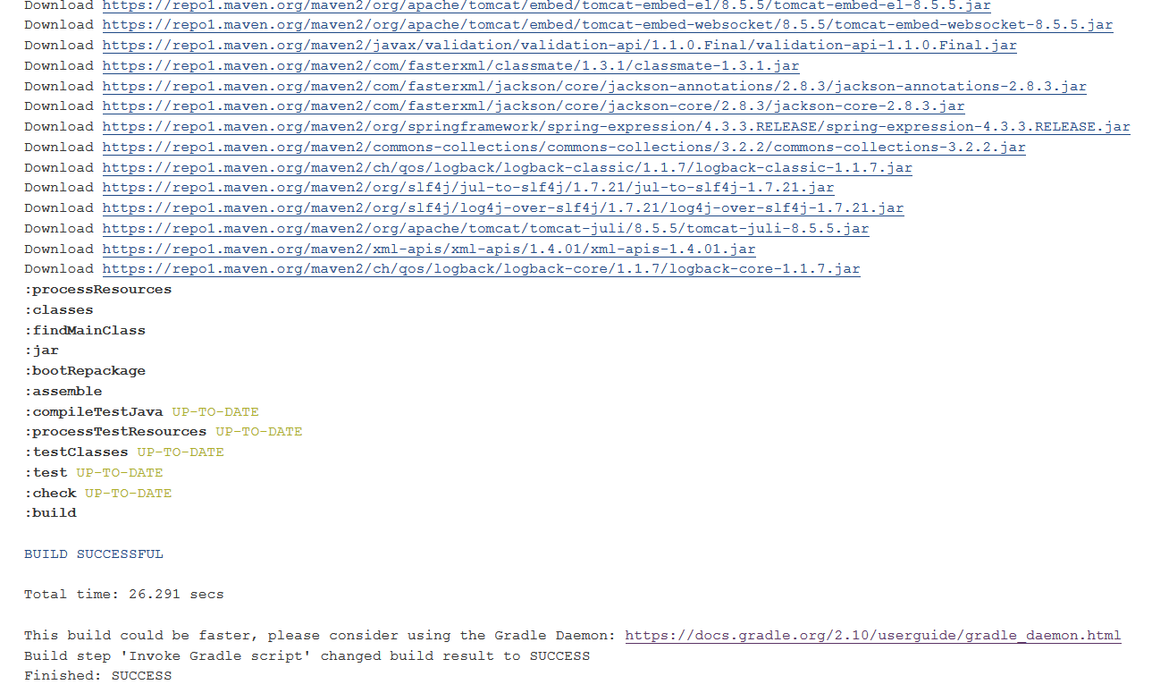
Gradle console output

Slide 17


Slide 18
What’s next?
When the login is successful navigation to the home screen
Home screen implementation
Creating groups
Finding friends (With name and number or registration ID)
Accepting/Declining the request
Push Notifications (When a friend request is sent using Google Play services)

Slide 19



